Slide 1
VERILOG PROJECT N-bit Multiplier with Binary to BCD Converter
Mehak Goyal
Arjun Narula

Slide 2
INTRODUCTION
This project is designed as an n-bit multiplier of two numbers. The multiplication is performed using the shift and add method of multiplying two numbers.
Once the multiplication is completed, the output result is also converted to its binary-coded decimal (BCD) representation.
This is done using the double dabble method of converting binary numbers to binary-coded decimal(BCD) .
In the output, both the binary and the binary-coded decimal (BCD) representation is shown.

Slide 3
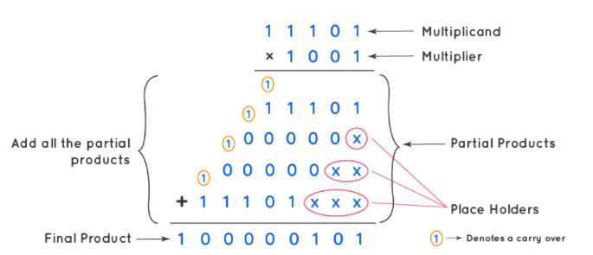
SHIFT AND ADD ALGORITHM
Consider two numbers 29 and 9
Their binary representation is 11101 and 1001
The result is 261
Their binary representation is 100000101

Slide 4

DOUBLE DABBLE ALGORITHM
Consider the number 151.
Its binary representation is 10010111

Slide 5
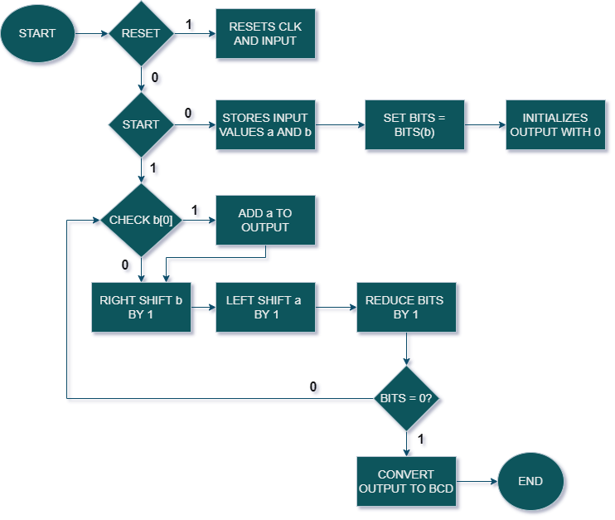
FLOW CHART

Slide 6
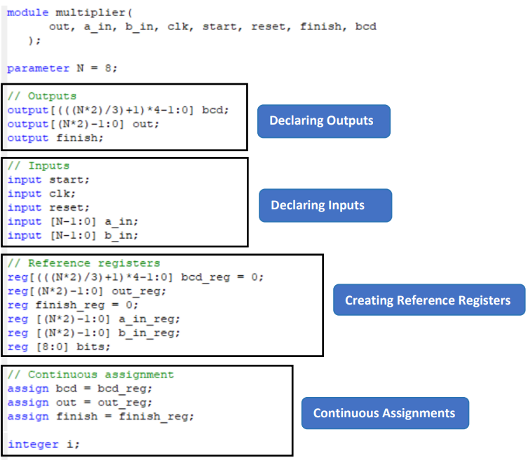
VERILOG CODE

Slide 7
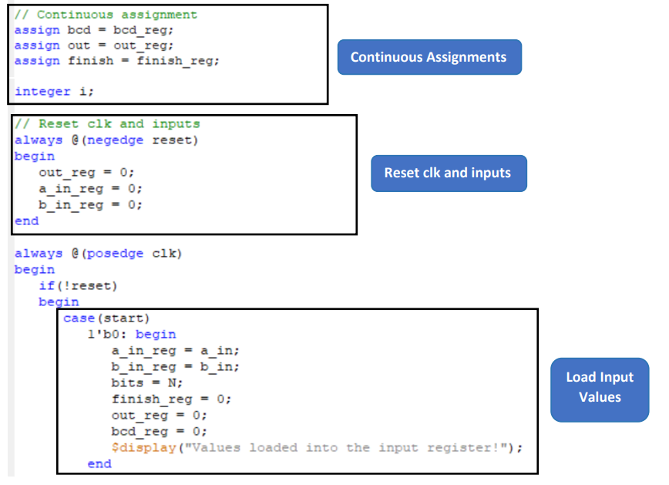
VERILOG CODE …continued

Slide 8
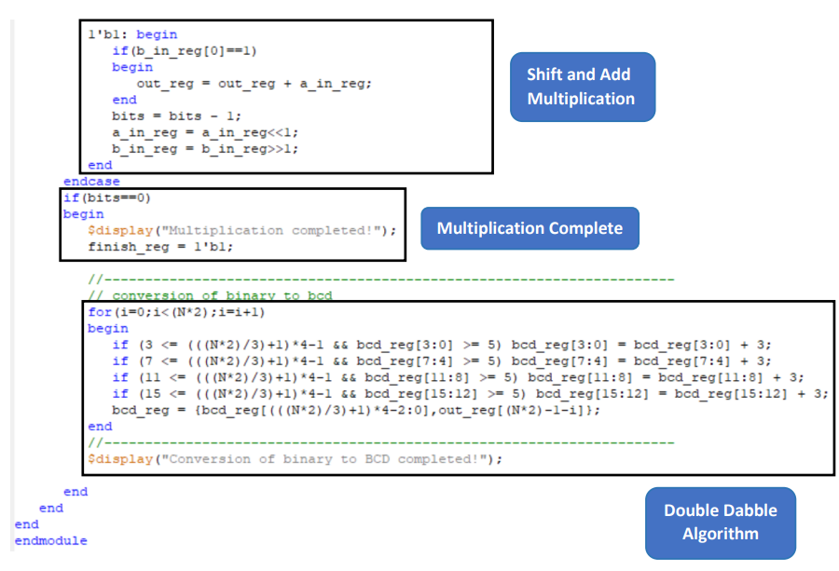
VERILOG CODE …continued

Slide 9
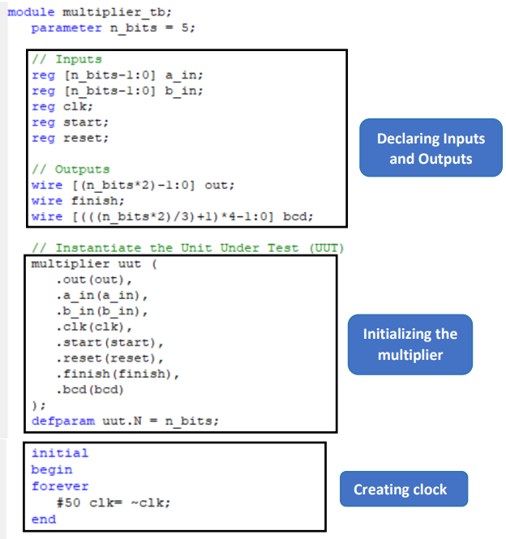
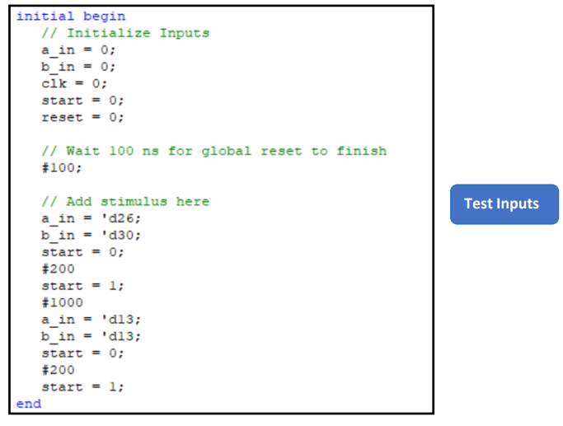
TEST BENCH

Slide 10
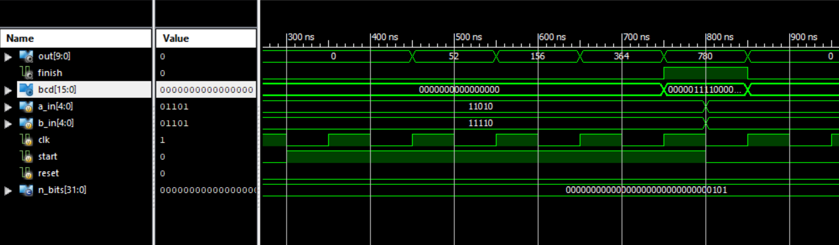
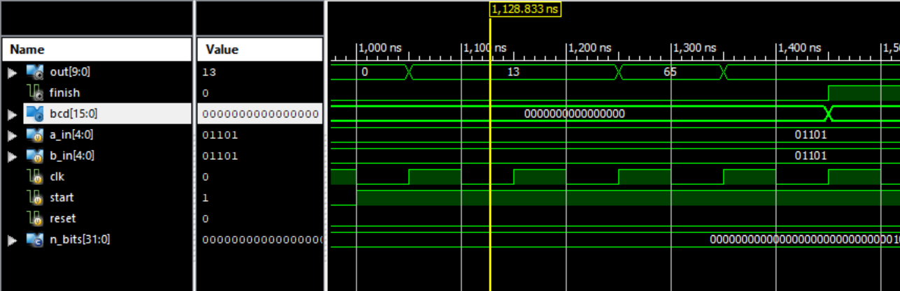
SIMULATION OUTPUT

Slide 11
OBSERVATIONS
The out represent the output of the multiplication of two numbers.
A value of 1 in finish signal indicates that the multiplication is complete while a value of 0 indicates that the multiplication is ongoing.
The clk and reset are input signals used to set the clock and reset the circuit to initial state respectively.
The bcd represents the binary-coded decimal representation of the output.
The a_in represents the input multiplicand.
The b_in represents the input multiplier.
A value of 0 in start loads the initial value into the registers, while a value of 1 performs the multiplication.

Slide 12


